Slide 1

Python 101

Slide 2
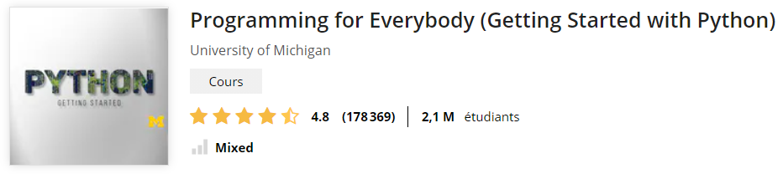
Plan
Datatypes (numerics, string, list, dict)
Functions, conditions, loops
Import/export data from files
Plotting
Manage packages, Notebooks & Environments

Slide 3
1. Datatypes
String
List
Dict
Numerics

Slide 4
Strings
6.1: A string is a sequence
6.2: Getting the length of a string using len
6.3: Traversal through a string with a loop
6.4: String Slices
6.5: Strings are immutable
6.6: Looping and Counting
6.7: The in operator
6.8: String Comparison
6.9: String Methods
6.E: Strings (Exercises)
6.G: Strings (Glossary)
6.10: Parsing strings
6.11: Format operator
6.12: Debugging
Python for Everybody – Chap 6 Strings
PY4E – HTML

Slide 5
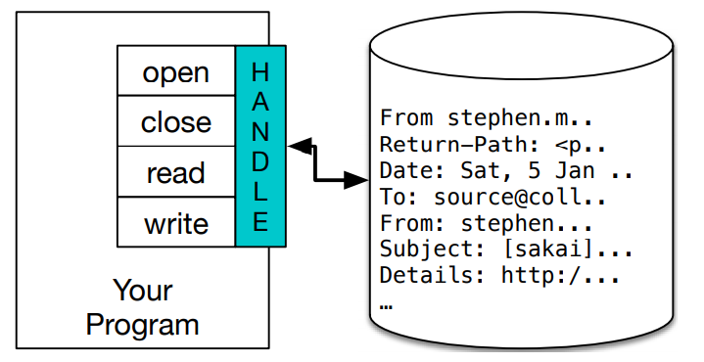
3. Input/Outputs
>>> fhand = open('mbox.txt’)
>>> print(fhand)
<_io.TextIOWrapper name='mbox.txt' mode='r' encoding='cp1252'>
Python for Everybody – Chap 7 Files

Slide 6
Reading files
fhand = open('mbox-short.txt’)
count = 0
for line in fhand:
count = count + 1
print('Line Count:', count)
https://www.py4e.com/code3/mbox.txt

Slide 7
Writing files
>>> fout = open('output.txt', 'w’)
>>> line1 = "This here's the wattle,\n“
>>> fout.write(line1)
>>> line2 = 'the emblem of our land.\n’
>>> fout.write(line2)
>>> fout.close()

Slide 8
List
8.1: A list is a sequence
Like a string, a list is a sequence of values. In a string, the values are characters; in a list, they can be any type. The values in list are called elements or sometimes items.
8.2: Lists are mutable
The syntax for accessing the elements of a list is the same as for accessing the characters of a string: the bracket operator. The expression inside the brackets specifies the index. Remember that the indices start at 0:
8.3: Traversing a List
The most common way to traverse the elements of a list is with a for loop.
8.4: List operations
The + operator concatenates lists.
8.5: List Slices
The slice operator also works on lists.
8.6: List Methods
Python provides methods that operate on lists. For example, append adds a new element to the end of a list:
8.7: Deleting Elements
There are several ways to delete elements from a list. If you know the index of the element you want, you can use pop.
8.8: Lists and Functions
There are a number of built-in functions that can be used on lists that allow you to quickly look through a list without writing your own loops:
8.9: Lists and Strings
A string is a sequence of characters and a list is a sequence of values, but a list of characters is not the same as a string. To convert from a string to a list of characters, you can use list.
8.E: Lists (Exercises)
8.G: Lists (Glossary)
8.10: Parsing lines
Usually when we are reading a file we want to do something to the lines other than just printing the whole line. Often we want to find the "interesting lines" and then parse the line to find some interesting part of the line.
8.11: Objects and Values
To check whether two variables refer to the same object, you can use the is operator.
8.12: Aliasing
The association of a variable with an object is called a reference. In this example, there are two references to the same object.
8.13: List arguments
When you pass a list to a function, the function gets a reference to the list. If the function modifies a list parameter, the caller sees the change. For example, delete_head removes the first element from a list.
8.14: Debugging

Slide 9
Exercises

Slide 10
Immo.py
Call a function price, that will return the price of real estate in Paris as a dictionary
Get a list of location (lat,lon) and price
Select only the estate under 500k€
Write a file containing this data
(Bonus: plot the data on a map)

Slide 11
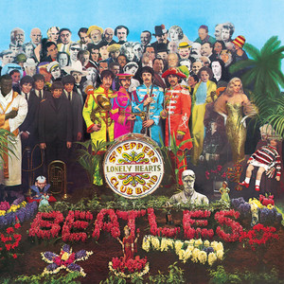
Music.py
Parse Streaming History
Create a dictionary
id
artist name
track name
Music Taste Analysis
Get music features
Plot features
Get recommendation

Slide 12
Music for loop
with open("saved_tracks_20210306.json","r") as f:
results = json.load(f)
tracks = []
for idx, item in enumerate(results['items']):
track = item['track']
tracks.append([idx, track['artists'][0]['name'], track['name']])

Slide 13
Music Dict
trackDict = {"id":[], "artist":[],"name":[]}
for idx, item in enumerate(results['items']):
track = item['track']
trackDict["id"].append(idx)
trackDict["artist"].append(track['artists'][0]['name'])
trackDict["name"].append(track['name'])

Slide 14
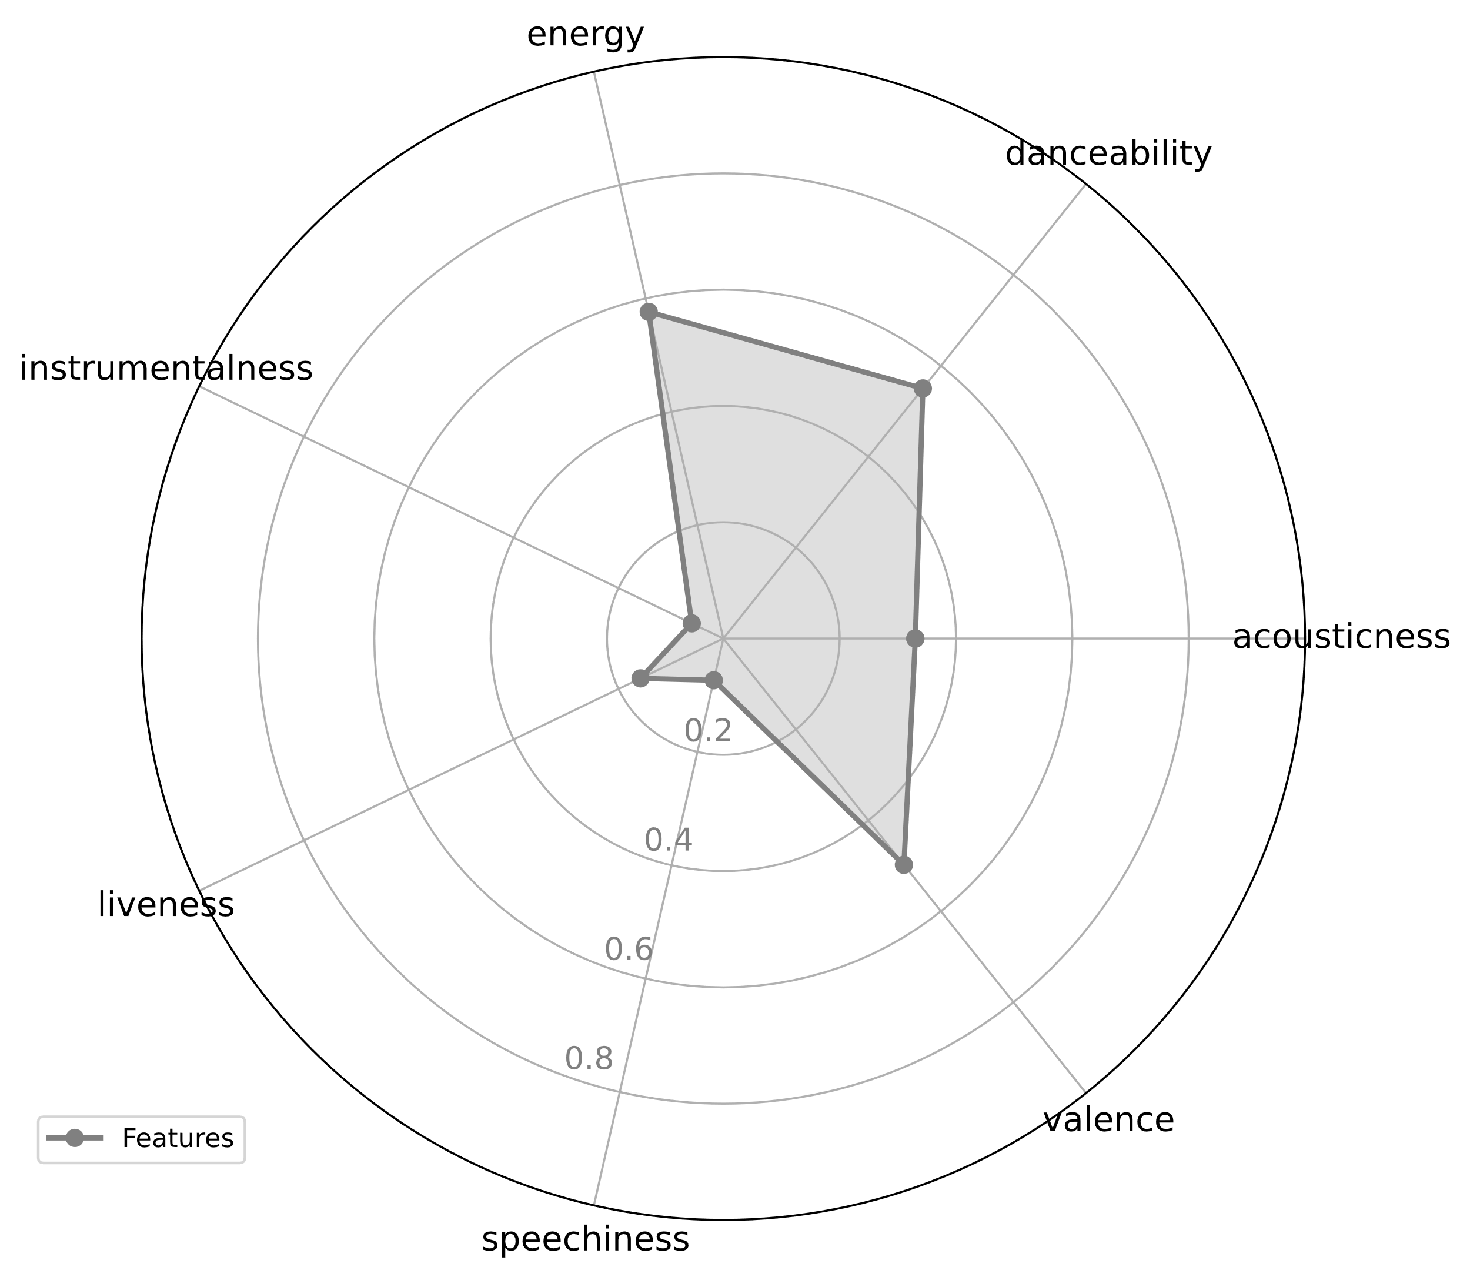
Music taste analysis

Slide 15
Music taste analysis
import spotifyAPI
from secret import clientId,clientSecret token = spotifyAPI.get_token(clientId,clientSecret)
lucy_id = spotifyAPI.get_track_id2('Lucy in the Sky', token, artist = 'The Beatles’)
url = "https://open.spotify.com/track/"+lucy_id
import webbrowser
webbrowser.open(url)

Slide 16
import pandas as pd
lucy_features = spotifyAPI.get_features(lucy_id,token)
df = pd.DataFrame(lucy_features, index=[0])
df_features = df.loc[: ,['acousticness', 'danceability', 'energy', 'instrumentalness', 'liveness', 'speechiness', 'valence’]]
spotifyAPI.feature_plot(df_features)

Slide 17
Music recommendation
json_response = spotifyAPI.get_track_reco(lucy_id,token)
uris =[]
for i in json_response['tracks']:
uris.append(i)
print(f"\"{i['name']}\" by {i['artists'][0]['name']}")

Slide 18

Sources
Data Structures
Using Python to Access Web Data
Using Databases with Python
Capstone: Retrieving, Processing, and Visualizing Data with Python
PY4E - Python for Everybody
Python for Everybody (dr-chuck.com)

Slide 19

Go further
Crash Course on Python | Google
Using Python to Interact with the Operating System
Google IT Automation with Python
Configuration Management and the Cloud
Troubleshooting and Debugging Techniques
Introduction to Git and GitHub | Google
Automating Real-World Tasks with Python | Google

Slide 20
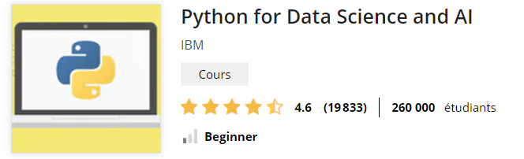
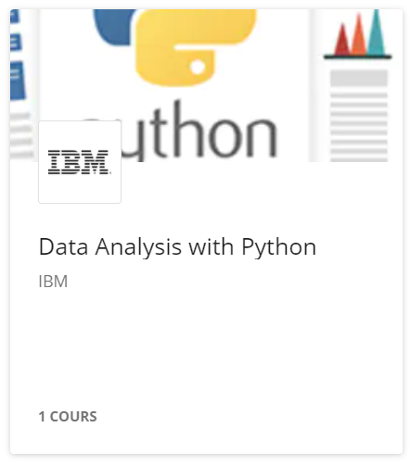
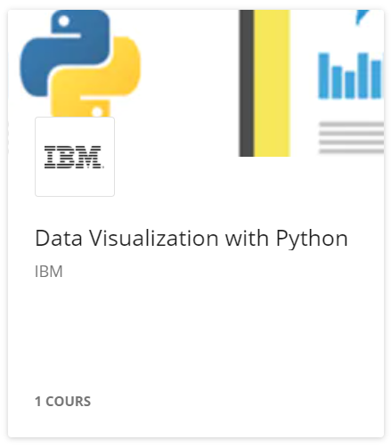
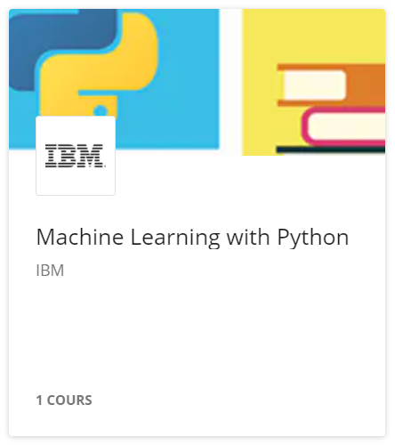
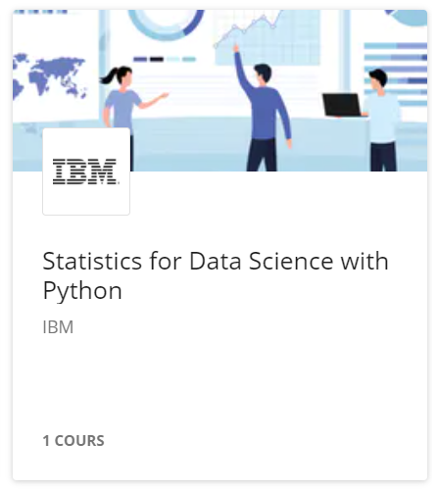
Data Science

Slide 21
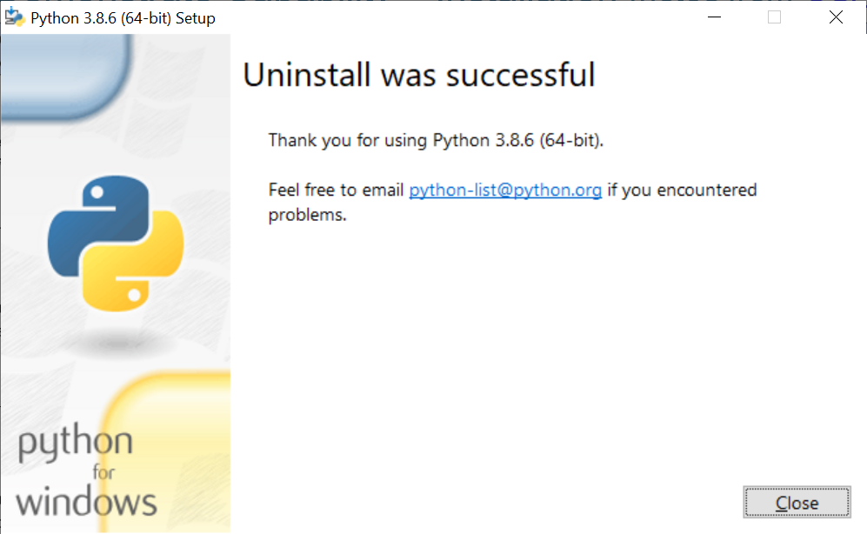
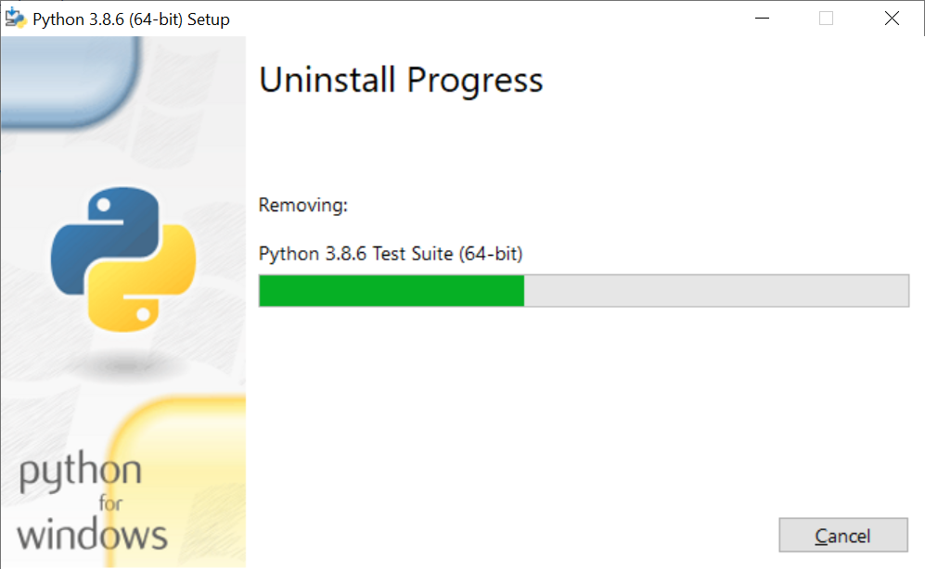
Uninstall Python

